Slide 1

Execution Plans
Module 8

Slide 2
Learning Units covered in this Module
Lesson 1: Execution plans in Synapse SQL Pool
Lesson 2: Obtaining the execution plan
Lesson 3: Reading the execution plan

Slide 3
Lesson 1: Execution plans in Synapse SQL Pool

Slide 4

Objectives
After completing this lesson, you will be able to:
Understand the following topics:
What is an Execution Plan in Azure Synapse SQL Pools
What are the differences between SMP and MPP plans

Slide 5
Execution plans in Azure Synapse SQL Pool
Define what steps will be executed to resolve a query
In Synapse SQL Pool, there are two types of execution plans:
MPP (Massively Parallel Processing)
SMP (Symmetric Multi-Processing)
Both are created based on statistics to determine the best approach
Notes:
What is an Execution Plan? To be able to execute queries, the system must analyze the statement (query submitted by the user) to determine the most efficient way to access the required data. The input consists of the query, the database schema (table and index definitions) and the database statistics. The output is a query execution plan, sometimes referred to as a query plan, or execution plan.
In Azure Synapse SQL Pools, there are two types of execution plans that work together: the MPP Plan and the SMP Plan. Every time a query is submitted, the Control Node generates a MPP Plan, which is composed by one or more steps. These steps can create/drop a temp table, move some data between the nodes or execute a query against them. For each of these steps that need to execute a query, a SMP Plan is generated by each node where que query will be run.
Find below a piece of explanation about the SMP and MPP architectures:
Symmetric Multi-Processing (SMP) is a tightly coupled multiprocessor system where processors share resources – single instances of the Operating System (OS), memory, I/O devices and connected using a common bus. SMP is the primary parallel architecture employed in servers.
Massively Parallel Processing (MPP) is the coordinated processing of a single task by multiple processors, each processor using its own OS and memory and communicating with each other using some form of messaging interface. MPP can be setup with a shared nothing or shared disk architecture. In a shared nothing architecture, there is no single point of contention across the system and nodes do not share memory or disk storage. Data is horizontally partitioned across nodes, such that each node has a subset of rows from each table in the database. Each node then processes only the rows on its own disks. Systems based on this architecture can achieve massive scale as there is no single bottleneck to slow down the system.
Although the following link approaches the differences between SMP and MPP architecture mentioning APS (PDW) it is still valid to understand the concepts, differences and objectives of MPP. Remember, the Azure Synapse Analytics uses the same MPP architecture:
https://cloudblogs.microsoft.com/sqlserver/2014/07/30/transitioning-from-smp-to-mpp-the-why-and-the-how/

Slide 6
MPP Plan
Also known as Distributed-SQL (D-SQL) Plan
It details all the operations or steps required to resolve the query
It is generated and orchestrated by the control node
Notes:
The MPP plan is also known as D-SQL Plan (Distributed-SQL Plan) because it contains all steps, regardless where they are going to be executed, which can be on the Control Node, on the Compute Nodes or across them (Data Movement Operations).
In the MPP plan, you can find relevant information about each step, like where it is going to be executed, the step command itself, the operation type, etc.
It is generated and orchestrated by the Control Node since it is the entry point of any query and contains statistics and schema information about how the data is distributed across the Compute Nodes.

Slide 7
MPP Plan: composition
Each MPP plan is composed by multiple steps
There are 4 different types:
SQL operations
Temp Table operations
Return
Passed internally SQL to compute nodes, which generate the SMP plans
Stage data for further processing
Push data back to client
Data Movement operations
Move data among nodes for satisfying query steps
Notes:
Inside the MPP plan, we can find all the necessary steps (+ details about them) to complete the query. There are 4 different types of steps:
SQL operations
Steps of this type are SQL commands that will be execute against the Control Node or against the Compute Nodes.
Temp Table operations
These steps are responsible for creating or dropping temp tables that are going to be used during the query execution.
Return
Return steps that will return data to the client after processing them.
Data Movement operations
Data Movement steps are responsible for moving data across the nodes and realign them (based on a new distribution) in order to process the query.

Slide 8
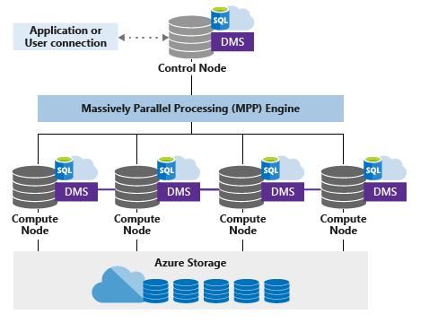
MPP Plan: in action
MPP Plan
SQL Operations
Temp Table Operations
Return Operations
Data Movement Operations
Notes:
As mentioned in the previous slides, the MPP plan is generated by the Control Node and it contains all steps needed to execute the query, which can be of 4 different types. Besides generating the execution plan, the Control Node is responsible for orchestrating all steps.
For example, for a SQL operation step which needs to be executed in all 60 distributions that are running across 4 different computes nodes, the Control Node will fire the query against each distribution simultaneously and monitor their execution. When all of them finishes, it will start the next step, which can be move data across the compute nodes to execute another SQL operation or a Return operation with the requested results.
If one of the distributions take more time to complete its individual query, the next step can’t start. On such situations, it’s important to understand how the MPP and SMP plans work together (besides having knowledge about how extracting information from some important DMVs) to figure out why that distribution is slowing down all query.
Important: In the slide above, the graphic used DMS to represent Data Movement, but the internal service is not called DMS, which is the component used by Polybase (external data movement).
In the link below, you can find extra information about the MPP architecture components in Synapse:
https://docs.microsoft.com/en-us/azure/synapse-analytics/sql-data-warehouse/massively-parallel-processing-mpp-architecture#synapse-sql-mpp-architecture-components

Slide 9
SMP Plan
Responsible for executing SQL operations
It is a regular execution plan (SQL Server)
Generated by the compute nodes
Executed against each distribution
Notes:
The SMP Plan is generated by the compute nodes based on each SQL operation inside the MPP plan (which was generated by the Control Node).
As you may remember from the previous slides, the MPP Plan may contain steps which are SQL operations that need to be executed against the distributions.
Inside the MPP plan we can find the SQL queries but only the query text. The execution plans for these queries (aka SMP plans) are generated by the Computes Nodes when these commands are executed against the distributions as part of the whole MPP plan.
The SMP plans are regular execution plans, containing operators (Scans, Seeks, etc.) and other properties we usually find in ordinary SQL Server environments.

Slide 10
Lesson 2: Obtaining the execution plan

Slide 11
Objectives
After completing this lesson, you will be able to:
Understand the following topics:
Different methods to obtain the MPP plan
How to obtain the SMP plan

Slide 12
Obtaining the MPP plan
EXPLAIN keyword
Display Estimated Execution Plan button
Query Store
In last case, by selecting the DMV sys.dm_pdw_request_steps
In the next slides, we will discuss in more detail each one of these options
Notes:
There are some ways to have access to the MPP plans inside Azure Synapse Analytics, especially when approaching the SQL Pools.
In this lesson we will cover 4 different ways:
Using the EXPLAIN keyword
Using the Display Estimated Execution Plan (as some of us may be used to do in regular SQL Server environments)
Query Store
DMV sys.dm_pdw_request_steps (which does not store only the queries in execution, but also some past executions as well)
In the next slides, we will discuss in more detail each one of these options.

Slide 13
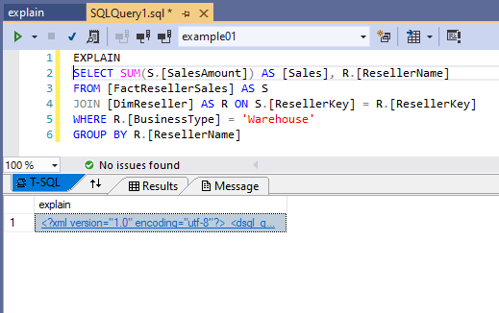
EXPLAIN
Returns the query execution plan (XML) for a SQL statement without running the statement
Used to preview which operations will require data movement and to view the estimated costs of the query operations
When using EXPLAIN in SSMS, it returns the execution plan as text while Visual Studio returns the same as XML already, making easier to analyze it.
Notes:
One of the easiest ways to have access to the MPP execution plan is through the EXPLAIN command. This command can be added before the query itself and when both are executed together the system returns the MPP plan in XML format instead of running the query.
Currently (Oct 2020) when using EXPLAIN in SSMS, the XML is returned as text. However, when used in Visual Studio, it is recognized as XML (as the slide above shows) and it makes easier to analyze the MPP plan because it opens the XML already formatted when you click on it.
https://docs.microsoft.com/en-us/sql/t-sql/queries/explain-transact-sql?view=azure-sqldw-latest

Slide 14
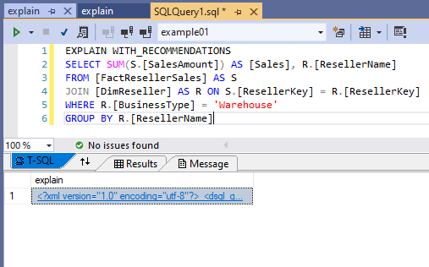
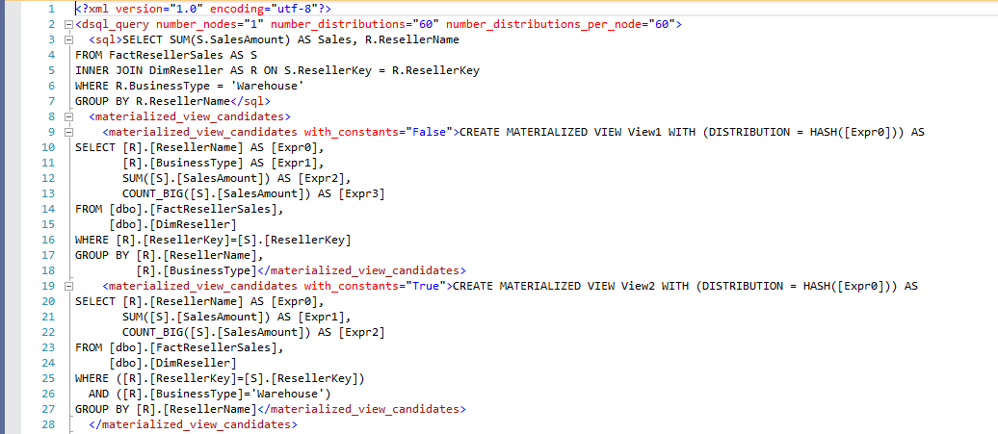
EXPLAIN [WITH_RECOMMENDATIONS]
Return the execution plan with recommendations (if any) to optimize the query performance
For example: If a materialized view can be created to improve the query, it would be in the execution plan XML under the tag <materialized_view_candidates>
Notes:
The EXPLAIN command has an additional argument (“WITH_RECOMMENDATIONS”) that currently (Oct 2020) can bring suggestions regarding materialized views that can be created to optimize that specific query.
Arguments:
SQL_statement
The SQL statement on which EXPLAIN will run. SQL_statement can be any of these commands: SELECT, INSERT, UPDATE, DELETE, CREATE TABLE AS SELECT, CREATE REMOTE TABLE.
WITH_RECOMMENDATIONS (Preview)
Return the query plan with recommendations to optimize the SQL statement performance.
Information about the recommendations:
<materialized_view_candidates> (preview) Contains the CREATE statement of the recommended materialized view for the SQL statement’s better performance.
https://docs.microsoft.com/en-us/sql/t-sql/queries/explain-transact-sql?view=azure-sqldw-latest

Slide 15
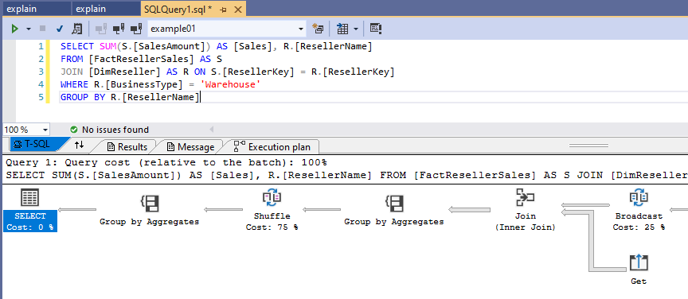
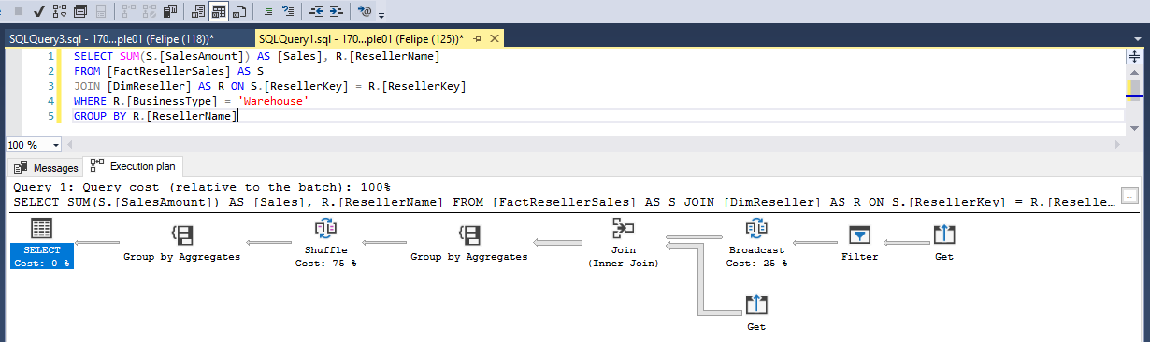
Estimated Execution Plan Button
Available on SSMS and Visual Studio
Display the execution plan graphically, also without running the query
Display Estimated Execution Plan
Notes:
Another way to preview the MPP plan before the query execution is by using the Display Estimated Execution Plan button that exists on both SSMS and Visual Studio. Differently than the EXPLAIN command, which brings the execution plan in XML format, this button shows the execution plan graphically, using operators and arrows to express the query execution flow. It is somewhat like what we are used to do in regular SQL Server environments.

Slide 16

Query Store
If the Query Store has been enabled for the database before the query execution, it is also possible to obtain the execution plan XML from the DMVs exposed by this feature
SELECT QT.query_sql_text, SP.query_plan
FROM sys.query_store_query SQ
INNER JOIN sys.query_store_query_text QT ON SQ.query_text_id = QT.query_text_id
INNER JOIN sys.query_store_plan SP ON SQ.query_id = SP.query_id
INNER JOIN sys.query_store_runtime_stats RS ON SP.plan_id = RS.plan_id
WHERE QT.query_sql_text LIKE 'SELECT%FactResellerSales%'
Notes:
If the query has been executed already and Query Store has been enabled (it is not enabled by default) before the query execution, you can retrieve the execution plan by using the DMVs exposed by this feature, which stores valuable information regarding queries performance, including the MPP plan and execution statistics.
Announcing the general availability of Query Store for Azure SQL Data Warehouse:
https://azure.microsoft.com/en-us/blog/announcing-the-general-availability-of-query-store-for-azure-sql-data-warehouse/

Slide 17
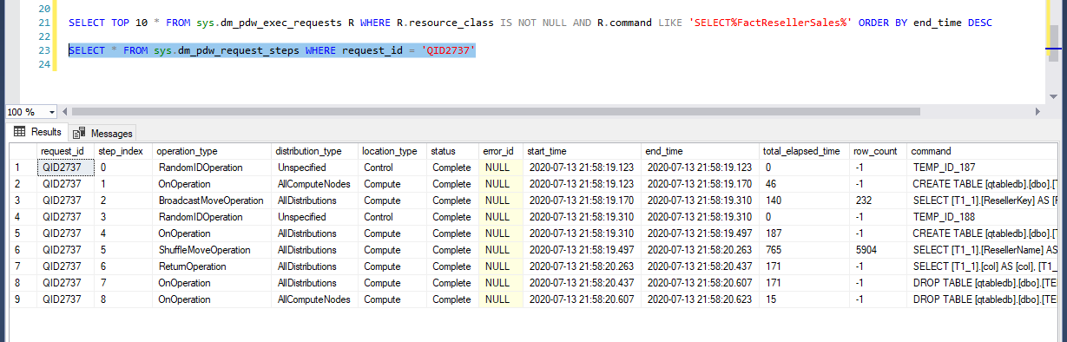
Selecting the DMV sys.dm_pdw_request_steps
If the query has been executed recently, it is possible to check the steps performed by the query by selecting the DMV sys.dm_pdw_request_steps
This DMV stores the last 10000 steps of all queries
The request_id can be identified by using the DMV sys.dm_pdw_exec_requests, which stores the last 10000 requests
Notes:
The DMV sys.dm_pdw_request_steps can be used to retrieve the steps executed as part of the MPP plan in order to finish the query execution. It also contains the elapsed time, the operation type, the status and the SQL command for each step.
Find below some useful queries:
--Query to check the running queries:
SELECT *
FROM sys.dm_pdw_exec_requests
WHERE status not in ('Completed','Failed','Cancelled')
AND session_id <> session_id()
--AND resource_class is NOT NULL
ORDER BY submit_time DESC;
--Check steps for a specific request_id:
SELECT req.session_id, req.start_time, req.end_time, reqSteps.location_type, reqSteps.total_elapsed_time, reqSteps.row_count, reqSteps.[status], reqSteps.command, reqSteps.step_index, reqSteps.operation_type, reqSteps.request_id
FROM sys.dm_pdw_exec_requests req
INNER JOIN sys.dm_pdw_request_steps reqSteps ON req.request_id = reqSteps.request_id
WHERE req.request_id = 'QID37964’
--Check all the distributions that have been already proceed.
SELECT *
FROM sys.dm_pdw_sql_requests
WHERE request_id = 'QID37964' AND step_index = 4 and status = 'Complete’
ORDER BY total_elapsed_time DESC;

Slide 18
Obtaining the SMP plan
In some cases, checking the execution plan on the distributions may be useful
To obtain it, we can use the command: DBCC PDW_SHOWEXECUTIONPLAN
The command requires 2 parameters: Distribution ID and SPID
These parameters can be obtained from DMVs (will be covered in the next slides)
Distribution ID
SPID
Notes:
In some cases, like when a distribution is taking too much time to finish its query in comparison to the others, it may be useful to check the SMP plan for that distribution. To do so, you can use the command DBCC PDW_SHOWEXECUTIONPLAN and inform the distribution ID and the SPID, which you can obtain by querying some DMVs that we will cover in the next slide.
https://docs.microsoft.com/en-us/sql/t-sql/database-console-commands/dbcc-pdw-showexecutionplan-transact-sql?toc=/azure/synapse-analytics/sql-data-warehouse/toc.json&bc=/azure/synapse-analytics/sql-data-warehouse/breadcrumb/toc.json&view=azure-sqldw-latest

Slide 19
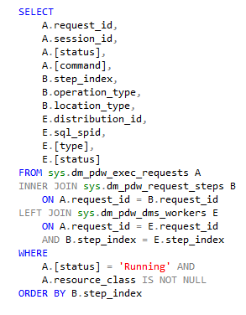
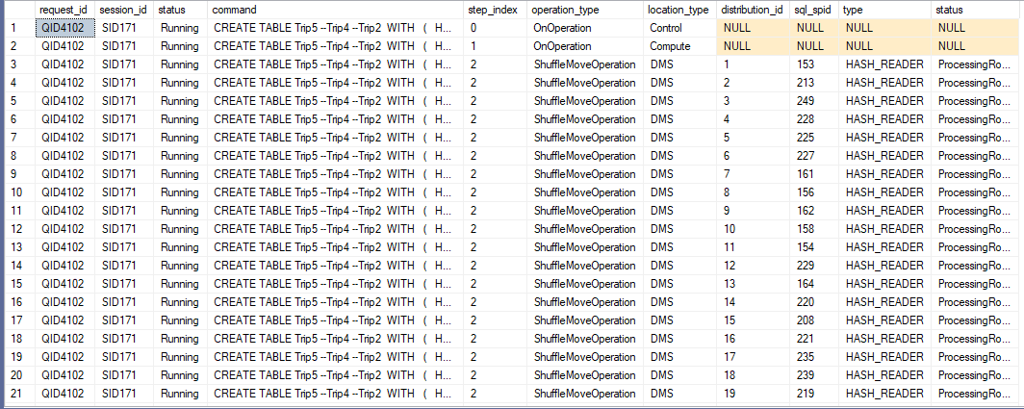
Obtaining the SMP plan: Distribution ID and SPID
If the query is running a data movement operation type step: sys.dm_pdw_dms_workers
Distribution ID
SPID
Notes:
As said in the previous slide, in order to execute the command DBCC PDW_SHOWEXECUTIONPLAN, you must provide two parameters: distribution id and SPID. There are basically two DMVs where you can find the required information to execute the command DBCC mentioned before.
The DMV you will use depends on the type of the operation being executed. If it is a Data Movement step, you can use the DMV sys.dm_pdw_dms_workers. Besides the distribution ID and SPID, it exposes some additional information that can be valuable to understand and track the progress of this type of operations. Some examples of interesting columns on this DMV are rows processed, bytes processed, bytes per sec, total elapsed time and CPU time.
You can find below the query used as an example in the slide:
SELECT
A.request_id,
A.session_id,
A.[status],
A.[command],
B.step_index,
B.operation_type,
B.distribution_type,
C.distribution_id,
C.spid,
C.[status],
C.command
FROM sys.dm_pdw_exec_requests A
INNER JOIN sys.dm_pdw_request_steps B ON A.request_id = B.request_id
LEFT JOIN sys.dm_pdw_sql_requests C ON A.request_id = C.request_id
AND B.step_index = C.step_index
WHERE A.[status] = 'Running' AND
A.resource_class IS NOT NULL
ORDER BY B.step_index, C.distribution_id, C.spid

Slide 20
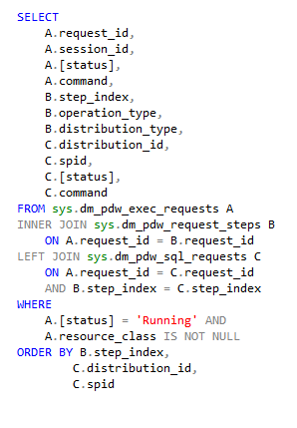
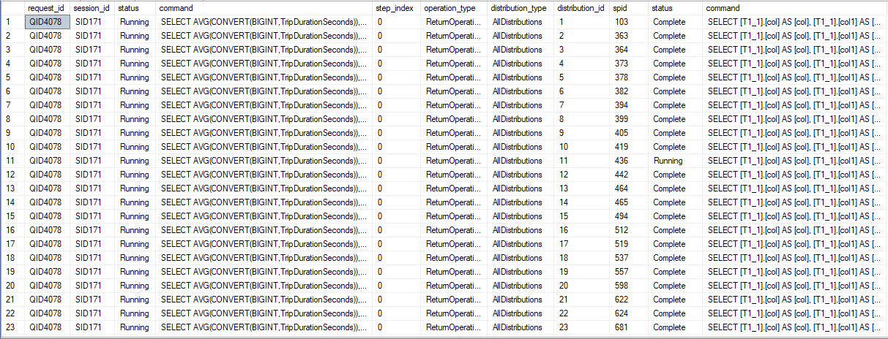
Obtaining the SMP plan: Distribution ID and SPID
If the query is running a SQL operation type step: sys.dm_pdw_sql_requests
Distribution which not completed the command yet
Distribution ID
SPID
Command executed in the distributions
Notes:
In case of the step is a SQL operation type, you can query the DMV sys.dm_pdw_sql_requests to obtain the distribution ID and SPID.
As with the Data Movement corresponding DMV, you can find additional information regarding SQL operations by querying this DMV. There also additional columns that can provide you some details like which distribution is taking more time, how many rows each distribution has processed and what SQL command it was used to perform that step.
You can find below a query example with only a few columns. However, keep in mind there are other columns in this DMV that can be helpful as well.
SELECT
A.request_id,
A.session_id,
A.[status],
A.[command],
B.step_index,
B.operation_type,
B.distribution_type,
C.distribution_id,
C.spid,
C.[status],
C.command
FROM sys.dm_pdw_exec_requests A
INNER JOIN sys.dm_pdw_request_steps B ON A.request_id = B.request_id
LEFT JOIN sys.dm_pdw_sql_requests C ON A.request_id = C.request_id
AND B.step_index = C.step_index
WHERE A.[status] = 'Running' AND
A.resource_class IS NOT NULL
ORDER BY B.step_index, C.distribution_id, C.spid

Slide 21
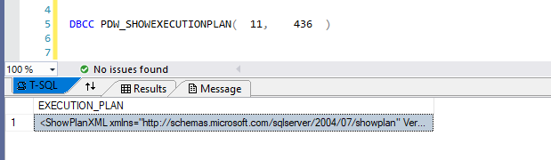
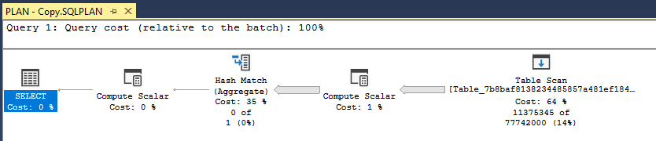
Obtaining the SMP plan
With the Distribution ID and SPID on hands
Run DBCC PDW_SHOWEXECUTIONPLAN
To visualize as a regular execution plan, save it as .sqlplan and open it
Notes:
After having obtained the distribution ID and the SPID you can finally execute the DBCC PDW_SHOWEXECUTIONPLAN and have access to the SMP plan executed by one of the distributions. As you can see in the slide, the command returns the query plan in text, even though it is an XML. To visualize it as a graphical query plan, you can save it with the SQLPLAN extension and open as a regular SQL Server execution plan.

Slide 22
Lesson 3: Reading the execution plan

Slide 23
Objectives
After completing this lesson, you will be able to:
Understand the following topics:
Understand the MPP execution plan
Read the MPP execution plan (XML and graphical)

Slide 24
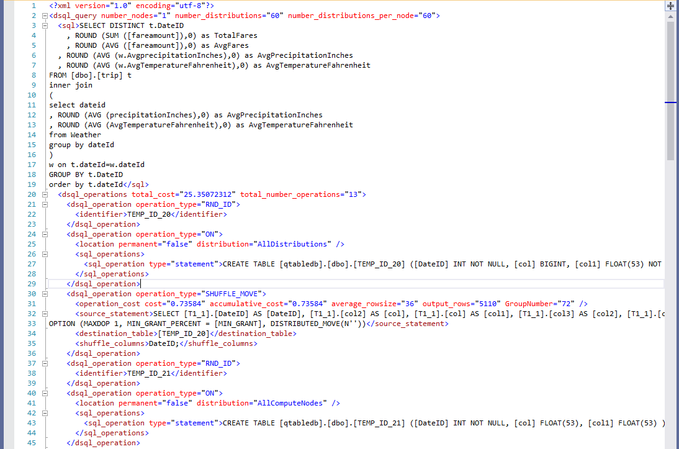
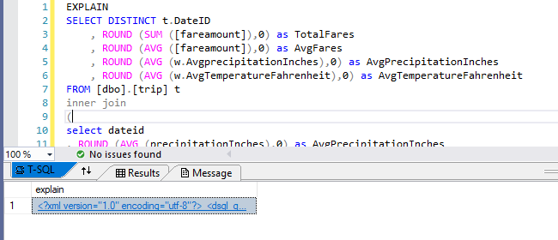
Reading an XML element: general structure
Query header, containing:
Number of nodes
Query executed by user
Query cost
Number of operations
Query steps, containing:
Type of operation
Operation Cost
SQL Command
Execution location
Notes:
As introduced in the previous slides, the MPP plan contains all steps that will be executed to fulfill the user query. When we add the command EXPLAIN before the query and obtain the MPP execution plan XML, we need to understand what information is in there.
First, there is a query header with some general information about that user query itself, like the query text, the query cost, number of operations and number of nodes (compute nodes) in the system at the time of execution.
Then we have as many XML nodes as query steps. Each node brings information about that step, like the operation type (for example, Shuffle move, which is a data movement operation), the operation cost and its location (compute nodes, control node) and the SQL command that will be in fact executed against the distribution.
The operation type is not explicitly available on the execution plan XML as we introduced in the previous slides, so it is important to look at the operation type and the command inside the XML. For example: in the slide example there are two pairs of operations with types RND_ID and ON. Observe that for each pair, in the second step, the SQL command is creating a table which name was defined in the previous step (TEMP_ID_20 and TEMP_ID_21, respectively) in a database called qtabledb, which didn’t exist. These steps are TEMP Table operations, and they are creating Temp Tables to be used in further steps in the same query.

Slide 25
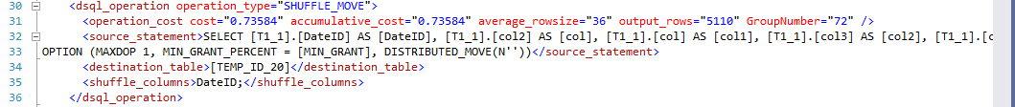
Reading an XML element: node structure (data movement)
Operation Type:
Shuffle Move
Operation cost
Accumulative cost
Output rows
Command to be executed in the distributions
Table name where data will be inserted by data movement and used in the further steps
Column used to distribute data after the operation
Notes:
Each XML node contains information about that step itself and we can find relevant information depending on the operation type. When looking at a Data Movement operation, we can find the operation type, which is a Shuffle Move. Besides this, there are some details about the operation cost and how many rows this step estimates to return. Then we have the SQL command that will be execute against the distributions to retrieve data and move across the compute nodes. We also have the Temp Table where this data will be inserted into. Finally, the column used to distribute the data after the movement is also shown.
All this information can be helpful to understand what decisions we can make to avoid huge data movements in a specific query and eventually take actions about the data distribution of a specific table used by important queries.

Slide 26
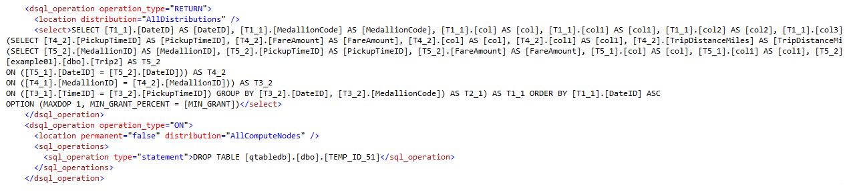
Reading an XML element: node structure (SQL query)
Operation type to be executed (Return / On = SQL operations)
Information about the location where the command will be executed
Command to be executed
Notes:
When it is an operation type that does not involve data movement (Return or Temp Table operations for example) there are other pieces of information available.
In the image above, we can see the operation type (which is a Return operation in the first step and a Temp Table operation in the second one), the SQL command that will be executed and where it will be executed (All Distributions and All Computes, respectively).

Slide 27
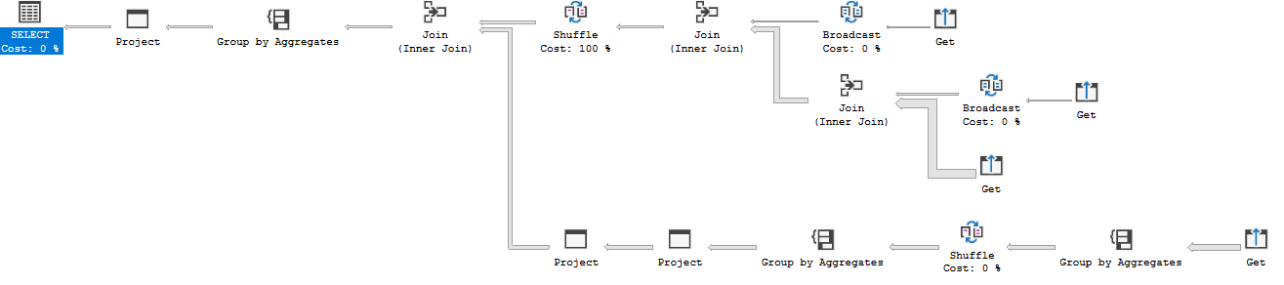
Reading a graphical plan
Like in SQL Server, execution plans should be read from up to down and from right to left
However, there are additional operators to represent DMS operations
From right to left
From up to down
Notes:
When analyzing the execution plan graphically, it is very similar to what we are used to do in regular SQL Server environments.
The execution plan is composed by operators and arrows that by its width indicate how many rows are estimated to be processed.
We also should read it from right to left and from up to down.
Although the graphics are very similar to regular SQL Server, there are specific operators in Azure Synapse Analytics to represent data movement operations (like Broadcast and Shuffle) and operators to represent other operations type (for example: Get, Filter and Project). It is important to have at least some knowledge about either graphic and XML because they expose different levels of information and you may need to check the XML to understand better a specific query.

Slide 28
Reading a graphical plan: execution flow
Although the graphical plan shows individual operators for each operation
Keep in mind that some operations can be performed together
For example: Get and Broadcast, Join and Shuffle
It is possible to see this difference when comparing XML and graphical plan
Notes:
Still regarding the graphical execution plan, please note that some operators may be performed together as a single step. The graphical execution plan shows the same information in a different way than the XML, including different levels of details.
This behavior can be viewed when you compare the graphical execution plan to the XML obtained using the EXPLAIN command. As said in the previous slide, this is one of the reasons it is important to have knowledge about reading both XML and graphical.

Slide 29
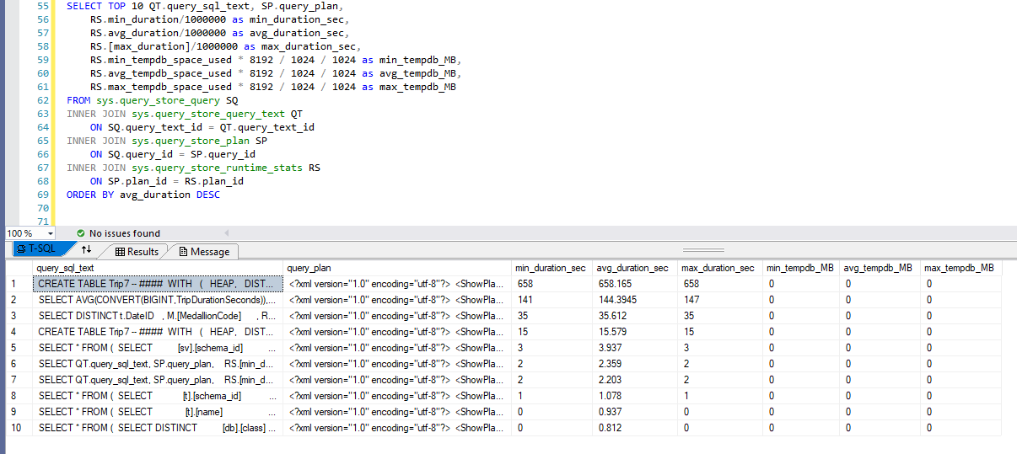
Comparing to runtime stats
When Query Data Store is enabled, it is useful checking the runtime stats DMV
It provides statistics about the query runtime and Tempdb usage
Notes:
There are useful information in Query Store when it is enabled. Besides providing the query plan XML, you can find in the DMV sys.query_store_runtime_stats some useful details, like average, max and min query execution times. Additionally, there is also a column detailing how much space from Tempdb was used by that query, which can help when troubleshooting Tempdb usage issues.
Remember: there are a plenty of other columns in this DMV, but some of them are not available to Azure Synapse SQL Pools. Check the documentation: https://docs.microsoft.com/en-us/sql/relational-databases/system-catalog-views/sys-query-store-runtime-stats-transact-sql?view=sql-server-ver15
SELECT TOP 10 QT.query_sql_text, SP.query_plan,
RS.min_duration/1000000 as min_duration_sec,
RS.avg_duration/1000000 as avg_duration_sec,
RS.[max_duration]/1000000 as max_duration_sec,
RS.min_tempdb_space_used * 8192 / 1024 / 1024 as min_tempdb_MB,
RS.avg_tempdb_space_used * 8192 / 1024 / 1024 as avg_tempdb_MB,
RS.max_tempdb_space_used * 8192 / 1024 / 1024 as max_tempdb_MB
FROM sys.query_store_query SQ
INNER JOIN sys.query_store_query_text QT
ON SQ.query_text_id = QT.query_text_id
INNER JOIN sys.query_store_plan SP
ON SQ.query_id = SP.query_id
INNER JOIN sys.query_store_runtime_stats RS
ON SP.plan_id = RS.plan_id
ORDER BY avg_duration DESC

Slide 30
Knowledge Check – Views
What information can we find in a MPP execution plan?
What are the methods to obtain the MPP execution plan?
What are the operations type we can have in a query execution plan?
Notes:
1. What is the difference between the MPP and SMP plans?
MPP plans contain all steps that will be executed to satisfy the user query, which can be temp tables creation/drop, data movement across the nodes, SQL operations to be executed in the compute nodes and return operations to bring data back to the client. There are a lot of details about each operation that can help on understanding the query execution process.
2. What are the methods to obtain the MPP execution plan?
EXPLAIN command. Display Estimated Execution Plan button available on SSMS and Visual Studio. Query Store DMV (when enabled). As a last resource, querying the DMV sys.dm_pdw_request_steps after the query execution.
3. What are the operations type we can have in a query execution plan?
SQL operations, Temp Table operations, Data Movement operations and Return operations.

